Slide 1
HANA- Information Views

Slide 2
Attribute Views
In SAP HANA, Attribute Views are used to model characteristics. They are used to join Dimension tables or other Attribute Views. You can also copy a new Attribute View from the already existing Attribute Views inside other Packages, but that doesn't let you change the View Attributes.
Following are the key characteristics of HANA Attribute view.
Attribute Views are used in Analytical and Calculation Views for analysis to pass the master data.
They are similar to characteristics in BM and contain the master data.
Attribute Views are used for performance optimization in large size Dimension tables. You can limit the number of attributes in an Attribute View, which are further used for reporting and analysis purpose.
Attribute Views are used to model the master data to give some context.

Slide 3
Attribute View- Types
Following are the categories of Attribute View sub-type −
Standard
Time
Derived
Time sub-type Attribute View is a special type of Attribute view that adds a Time Dimension to Data Foundation. When you enter the Attribute name, type, and sub-type and click Finish,
it will open three work panes −
Scenario pane that has Data Foundation and Semantic Layer.
Details pane that shows the attribute of all tables added to Data Foundation and joining between them.
Output pane where you can add attributes from the Detail pane to filter in the report.

Slide 4
Analytic View
Analytic View is in the form of Star schema, wherein we join one Fact table to multiple Dimension tables.
Analytic views use real power of SAP HANA to perform complex calculations and aggregate functions by joining tables in the form of Star schema and by executing Star schema queries
Key characteristics of SAP HANA Analytic View −
Analytic Views are used to perform complex calculations and Aggregate functions such as Sum, Count, Min, Max, etc.
Analytic Views are designed to run Star schema queries.
Each Analytic View has one Fact table surrounded by multiple dimension tables. Fact table contains a primary key for each Dim table and measures.
Analytic Views are similar to Info Objects and Info sets of SAP BW.
SAP BusinessObjects reporting tools can connect to Analytic view using an OLAP connection for reporting and dashboard.

Slide 5
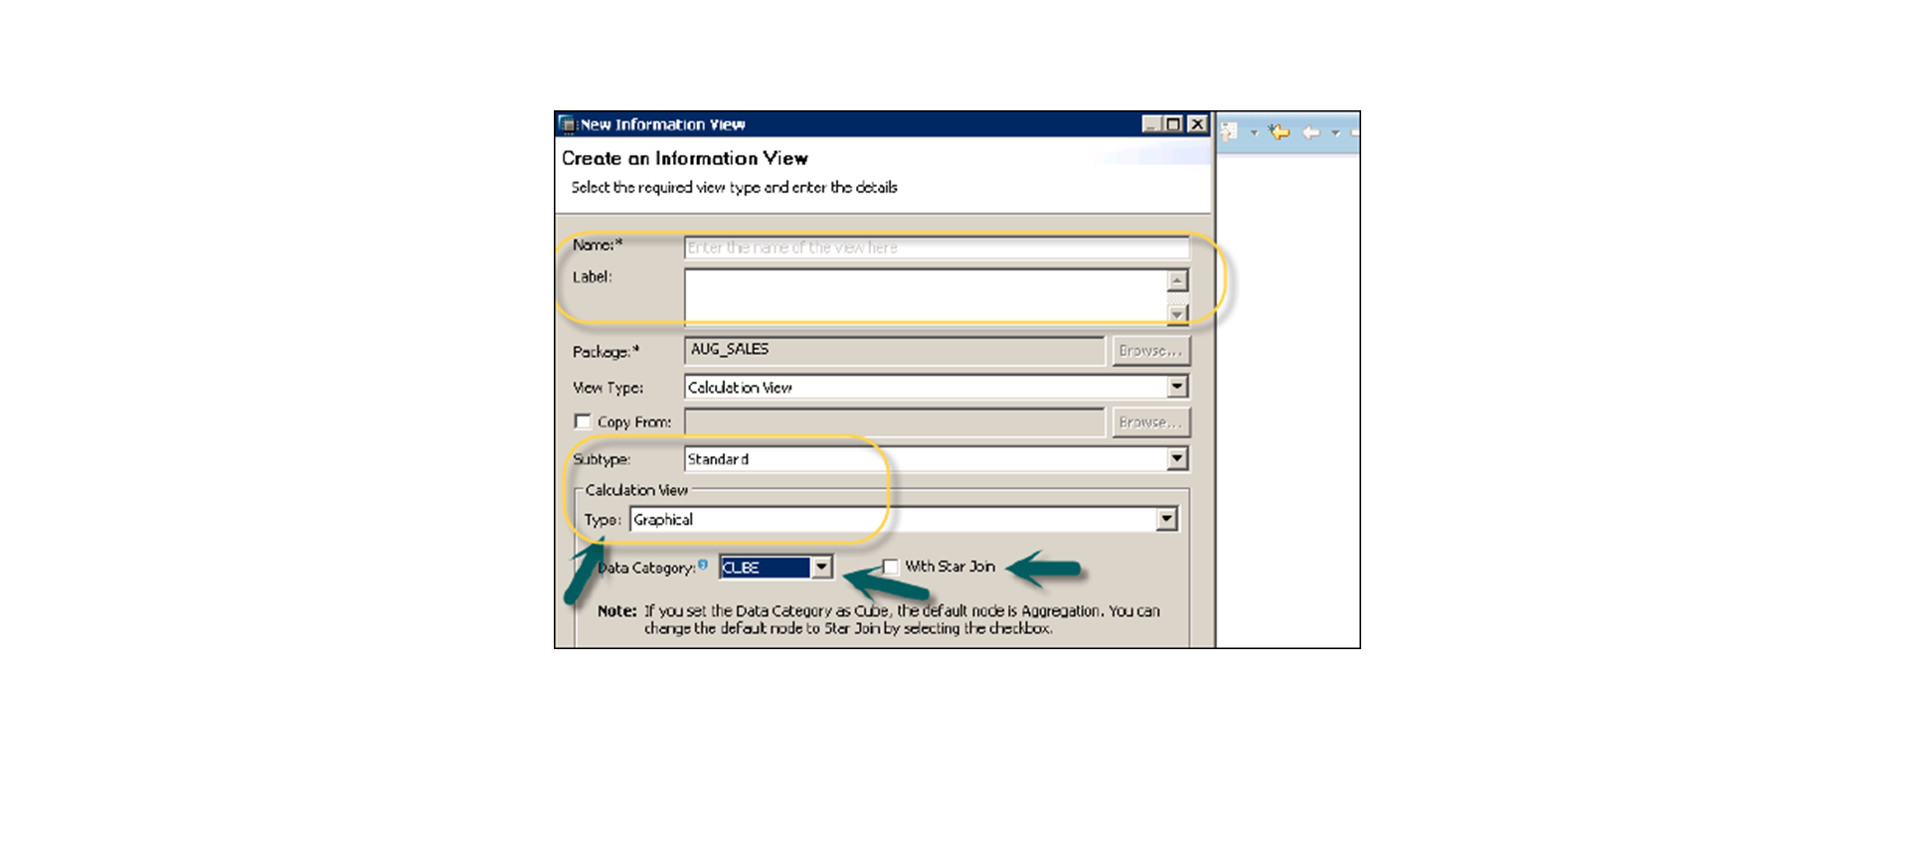
Calculation View
Calculation views are used to perform complex calculations, which are not possible with Attribute or Analytic view.
You can also use Attribute and Analytic views while designing Calculation views.
Calculation view types −
Standard
Cube − When a user selects Cube as data category, the default node is Aggregation. You can choose Star Join with Cube dimension.
Dimension − When a user selects Dimension as data category, the default node is Projection. SQL Script Based
2. Time Based
Gregorian
Fiscal

Slide 6
Calculation View- Standard
Dimension Calculation View
1. Default view is projection
2. Is used to expose master data
3. Cannot create measures using dimension views
4. If you add any numeric column in the dimension view, it will be considered as an attribute
Cube Calculation view
Default view is Aggregation.
Is used to expose attribute and measures
Cube with Star Join
Default node is star join
It is an extension to cube dimension cube
It follows star join concept like one fact table and multiple dimension table

Slide 7
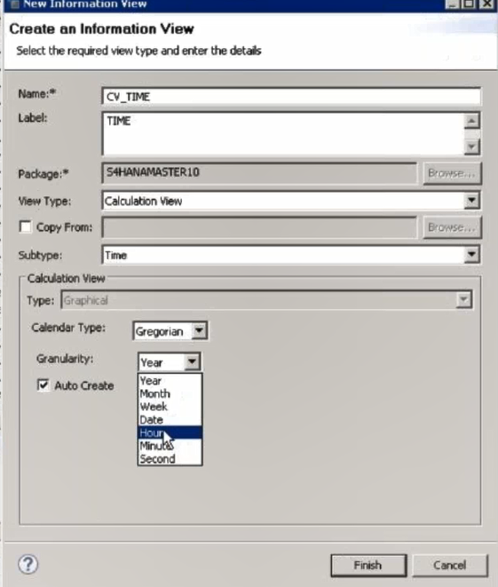
Time Calculation View
1. Gregorian – It has granularity like calendar year , month and even further to hours and minutes and seconds.
2. Fiscal –It has granularity as fiscal year and fiscal variant
Both are related to time-based calculation view where data is related to time
It is used to define measure based on different calendar days

